Slide 1

Evaluation of Saliva Procurement and Integrated Testing (SPIT) booklet in Measuring Cortisol and DHEA Levels
Marshall Roll

Slide 2
Research Questions
Internal consistency of timing (if on average, cap and booklet times were similar)
Mixed model with random intercepts for participants
Repeated measures correlation on complete cases
Treatment adherence
Descriptive statistics
Association between time since wake and cortisol and DHEA levels
Piecewise linear regression models with random intercepts for participants
Knot at 30 minutes
Data: 31 healthy individuals collecting saliva samples at wake, 30 minutes after wake, at lunch time, and 600 minutes after wake for 3 days consecutively

Slide 3
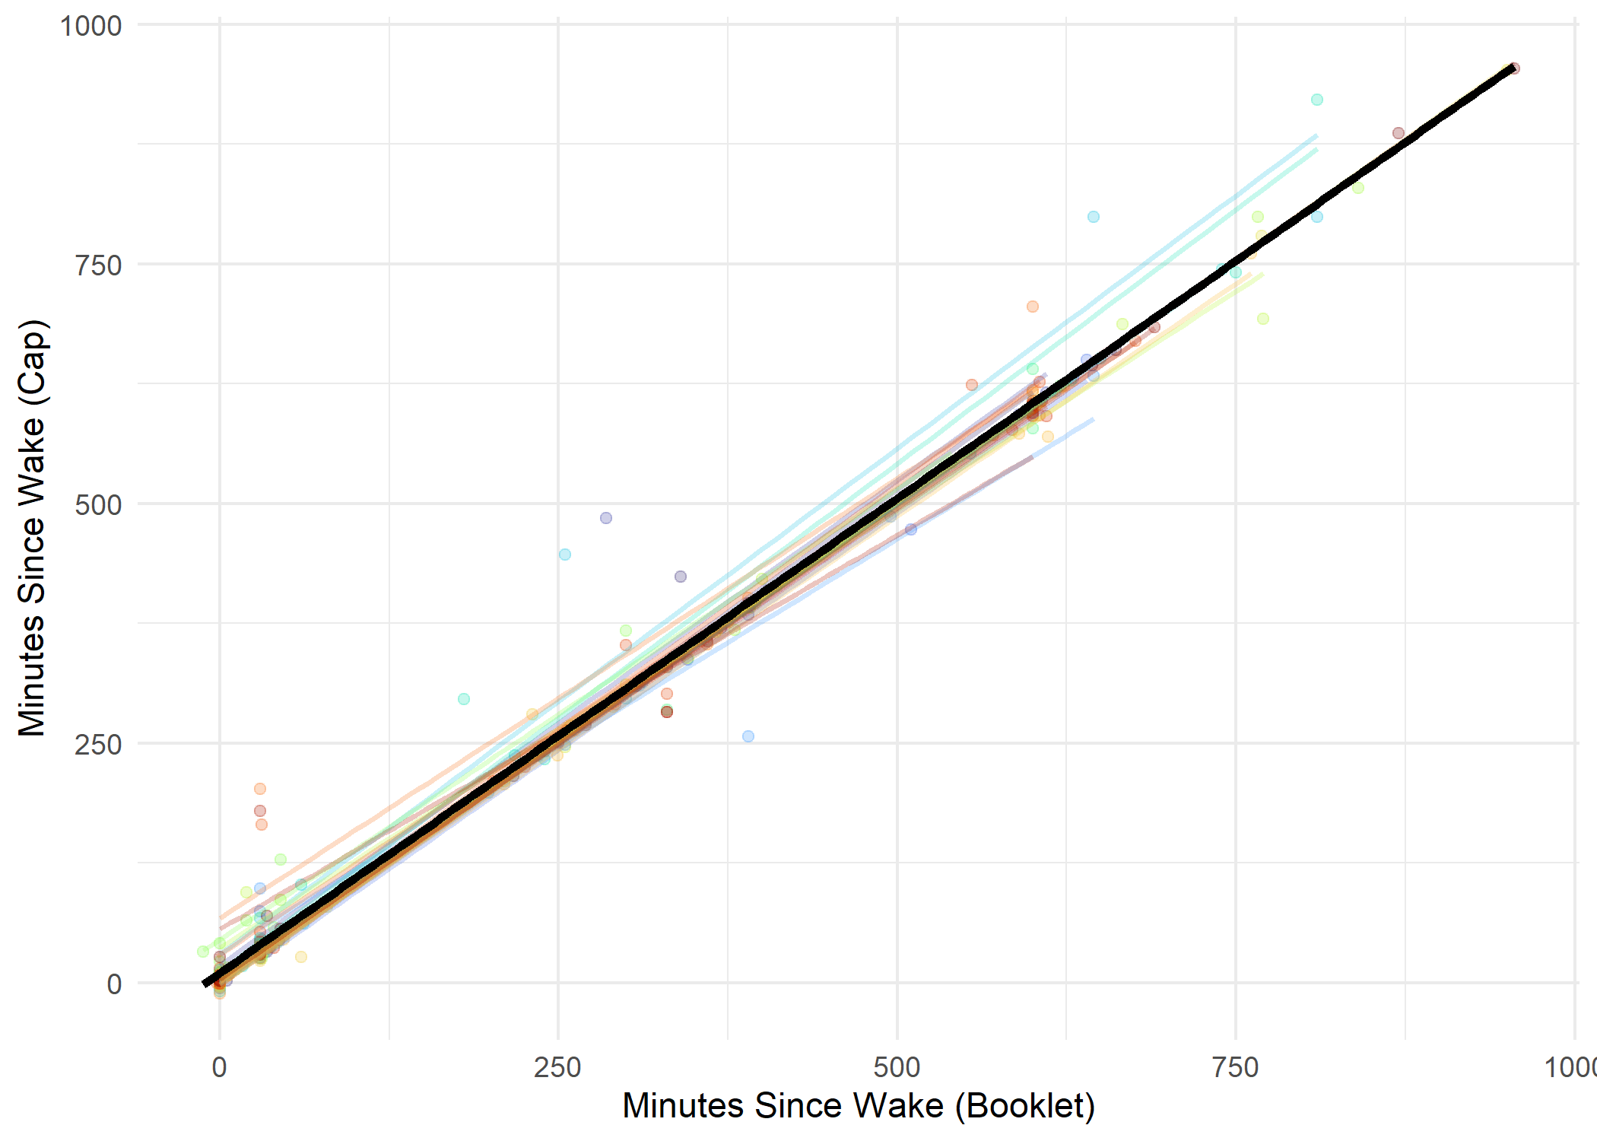
Cap readings occur an average of about 10 minutes later than booklet recordings
Strong agreement between cap & booklet (repeated measures correlation, r = 0.99)

Slide 4
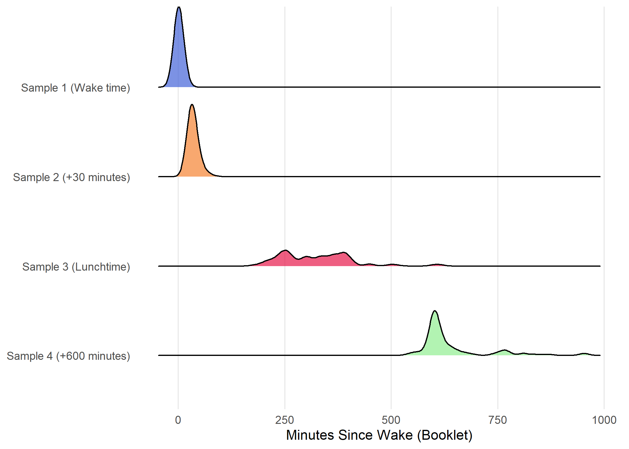
Good: 73%, Adequate: 84%
Good: 40%, Adequate: 48%

Slide 5
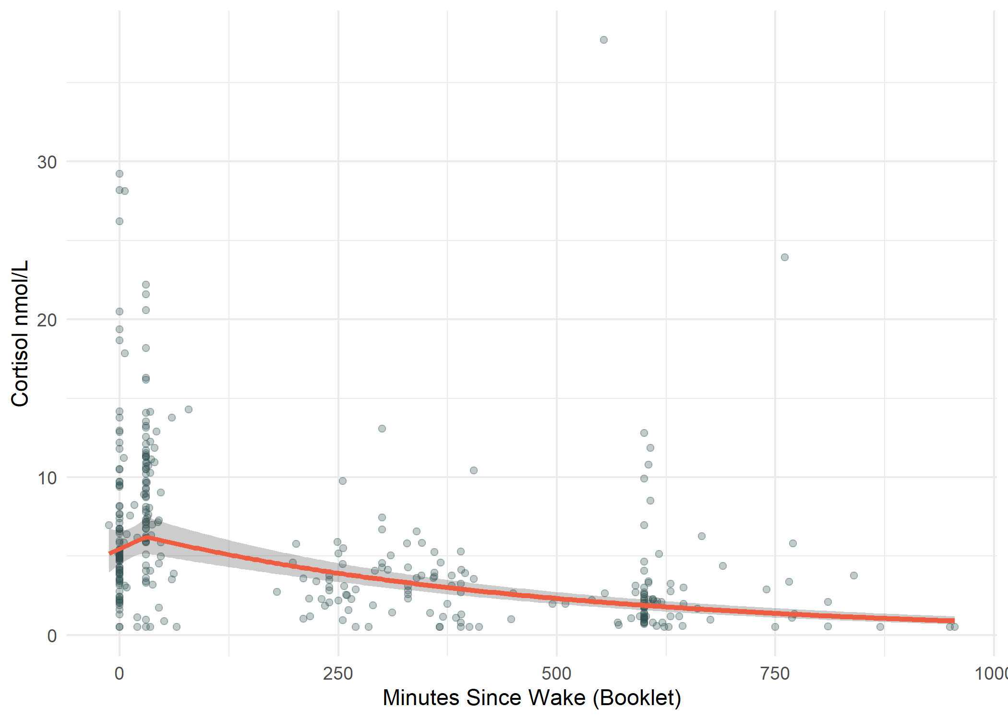
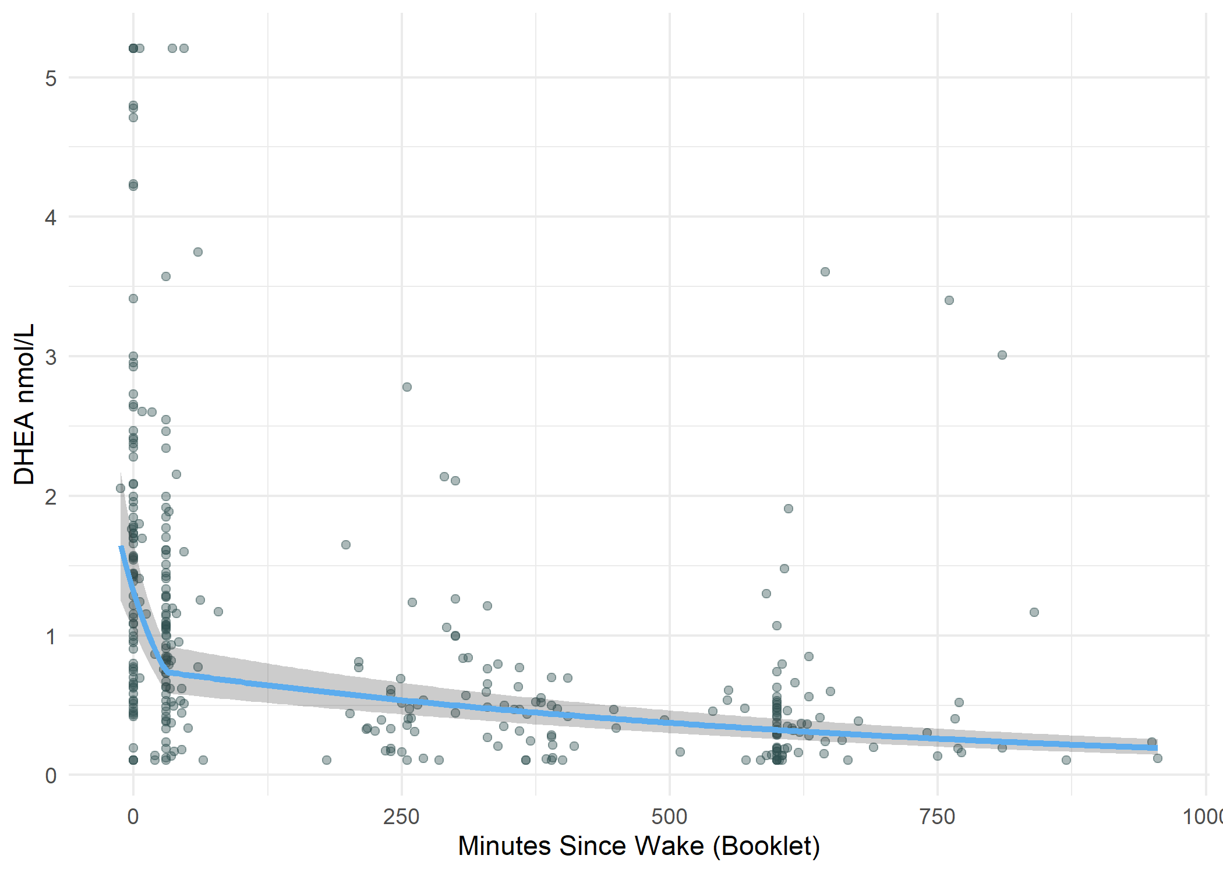
Time Since Wake | Mean Percent Change/30 min. | 95% CI
0-30 minutes | 13.99 | (-10.99, 45.98)
After 30 minutes | -6.10 | (-7.27, -4.92)
Time Since Wake | Mean Percent Change/30 min. | 95% CI
0-30 minutes | -43.60 | (-54.2, -30.55)
After 30 minutes | -4.26 | (-5.26, -3.24)

Slide 6
Conclusions
Strong internal consistency of timing
Booklet time preferable cap time
Adherence lower for later time points
Cortisol spikes at 30 minutes then decreases steadily, DHEA decreases sharply after wake then decreases more steadily
Limitations
Reporting bias
Serial correlation
Sample size, population characteristics

